Slide 1
A Tale of Two Cities
Chitra Sharathchandra, Gabriela Huelgas Morales, Guillermo Ruiz Cavero, Juan Vasquez, Yukti Kathuria

Slide 2


Motivation
US renters paid $512.5 billion in rent in 2019
Phoenix had the highest growth rate of 7.6% in 2019
Tampa wasn’t far behind with 4.0%
Zillow Rental Index is the primary indicator for trend of rental prices in the US

Slide 3
Goal
Gain insights on important factors that influence the rental values of homes and apartments in Phoenix and Tampa.
Explored Zillow Rent Index (ZRI) provided by 7Park
Studied American Census Survey (ACS) data
Predicted ZRI based on ACS data

Slide 4
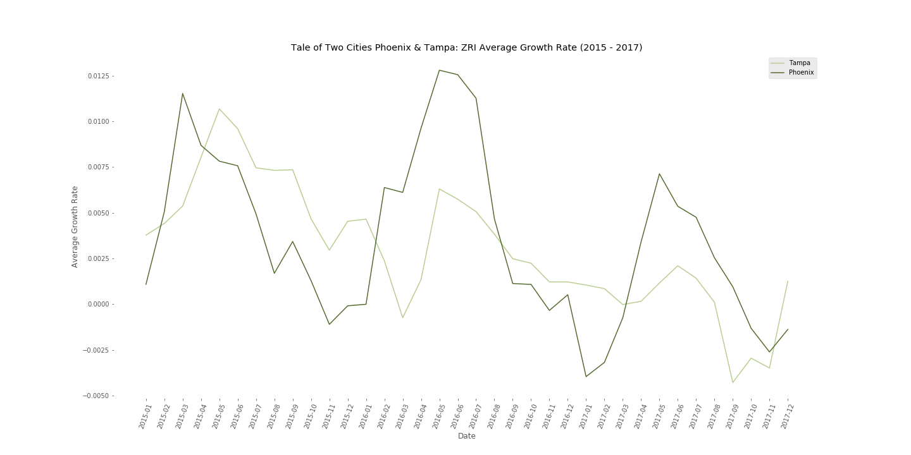
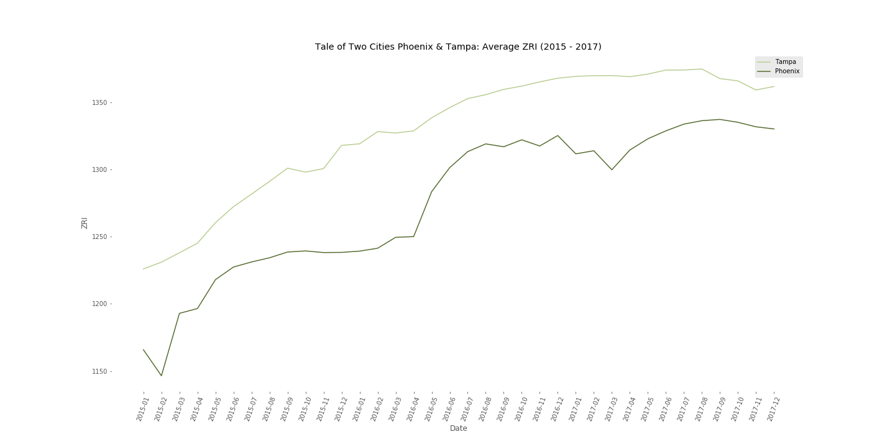
Tale of Our Target Variable
Phoenix and Tampa ZRI Average Growth Rate (2015-2017)
Phoenix and Tampa Average ZRI (2015-2017)
ZRI
Average ZRI Growth Rate
Month
Month

Slide 5
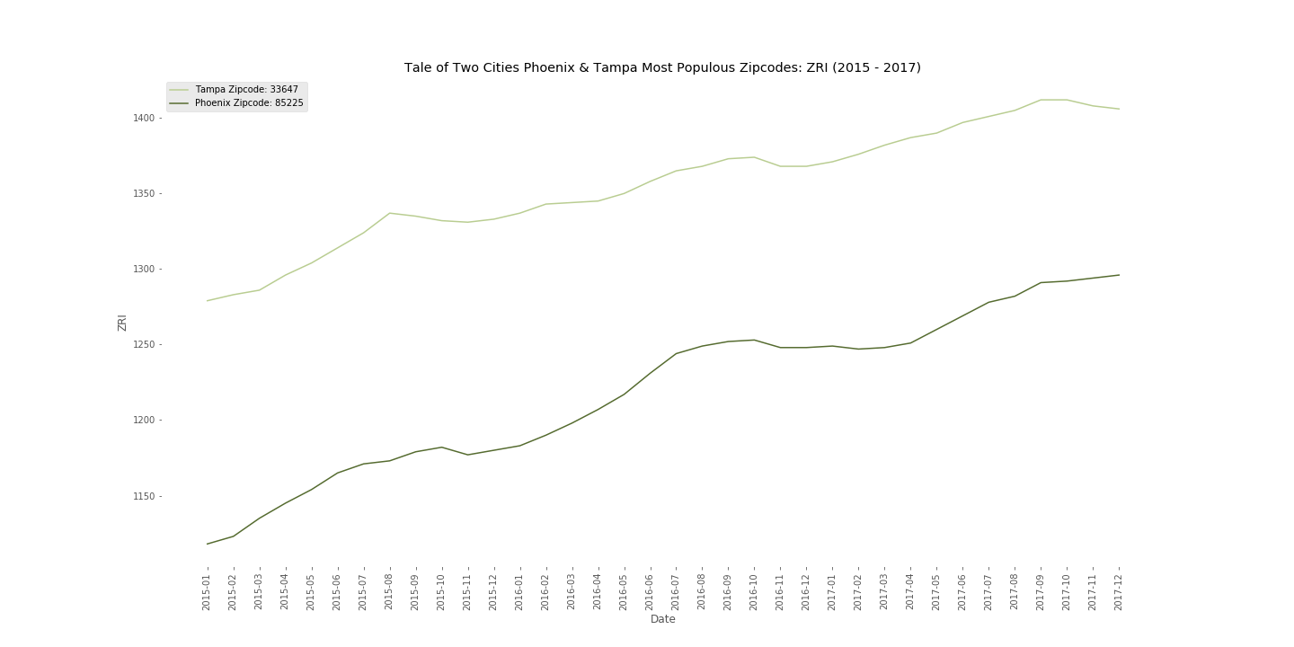
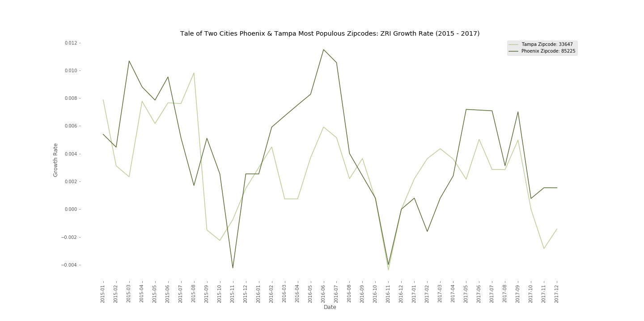
Tale of Our Target Variable
Phoenix and Tampa Most Populous Zipcodes ZRI (2015-2017)
Phoenix and Tampa Most Populous Zipcodes ZRI Average Growth Rate (2015-2017)
ZRI
Average ZRI Growth Rate
Month
Month

Slide 6
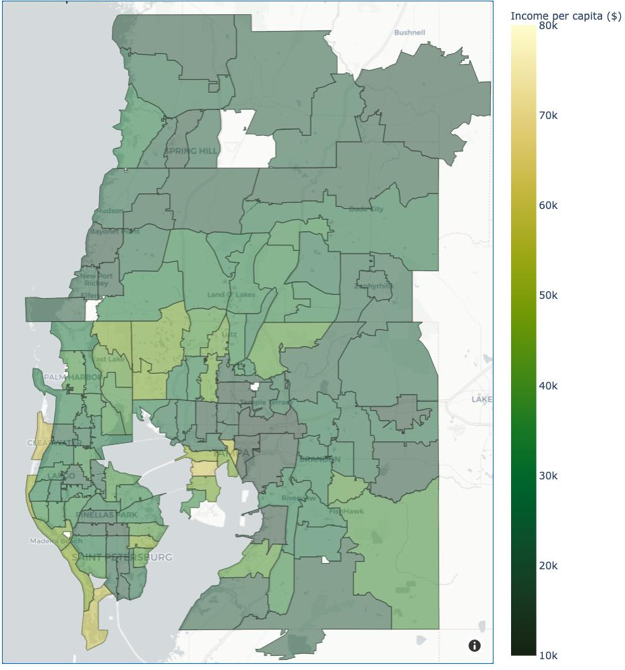
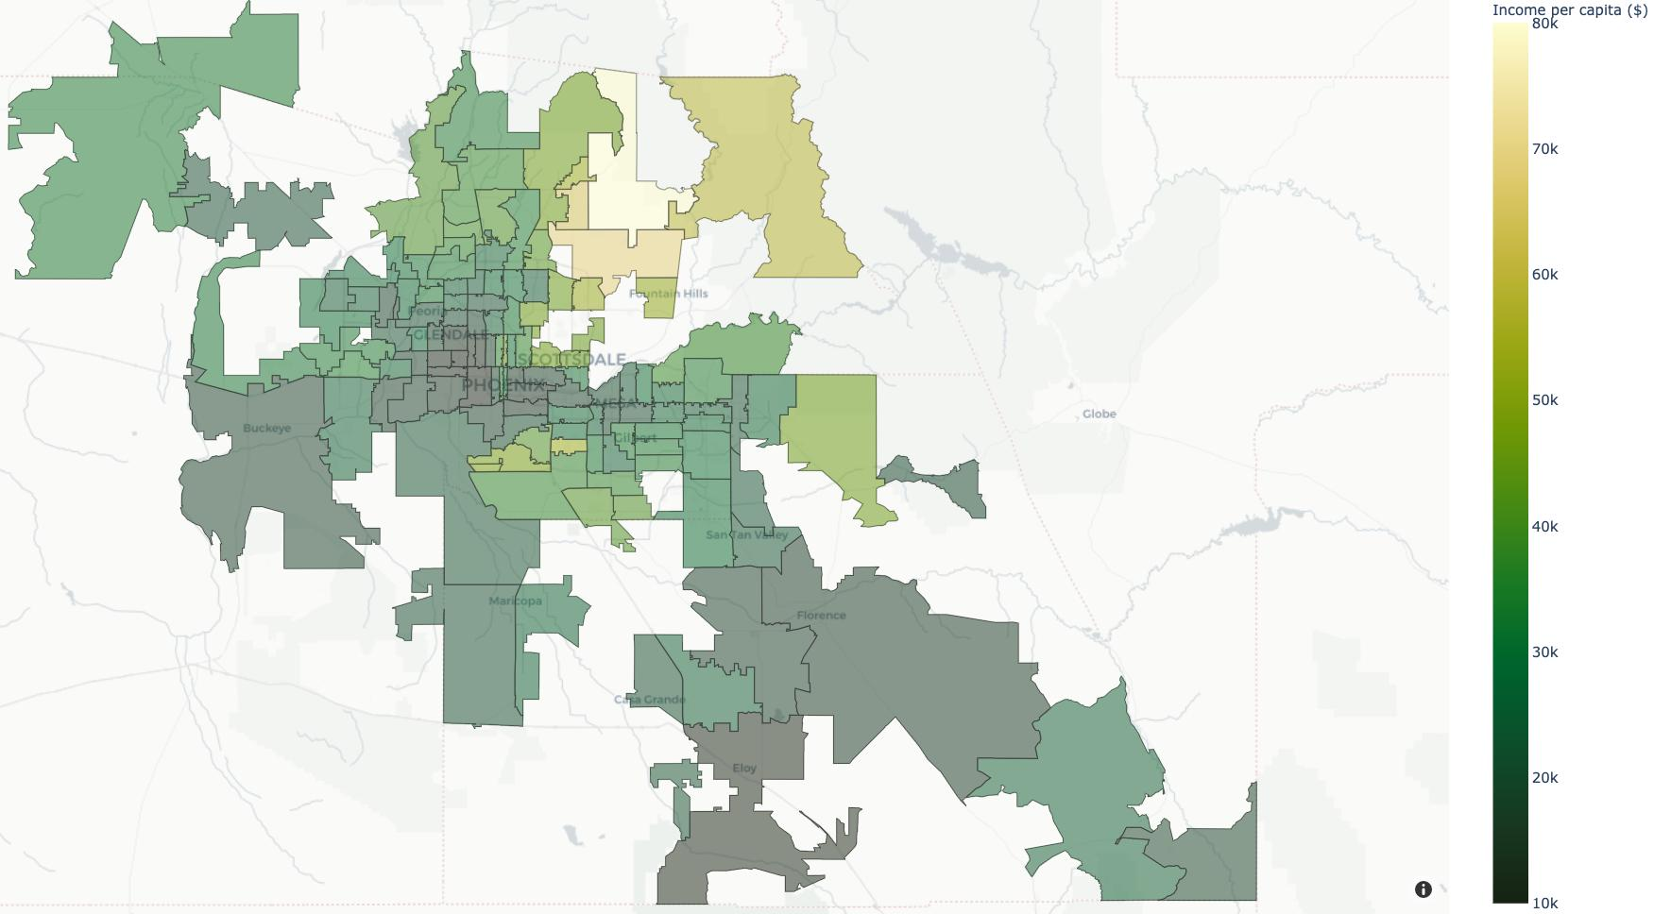
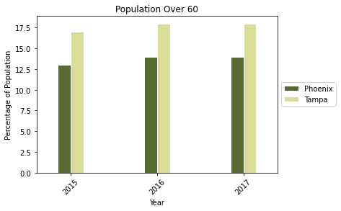
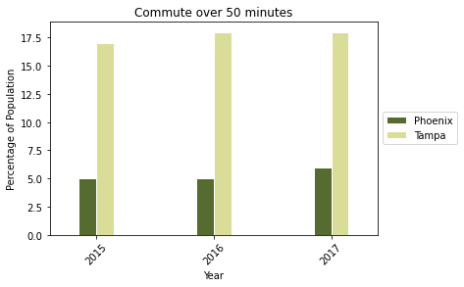
Ways Tampa and Phoenix Are Different
Income per capita
70 K
Tampa
50 K
Phoenix
30 K
Demographics: age
Geography and per capita income
Travel and commute
Travel or commute time

Slide 7
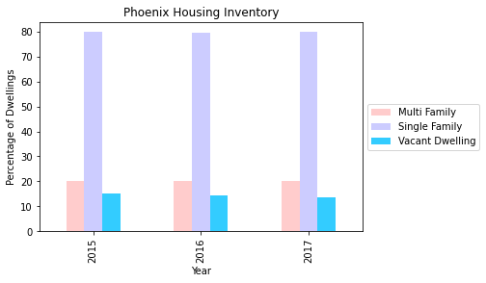
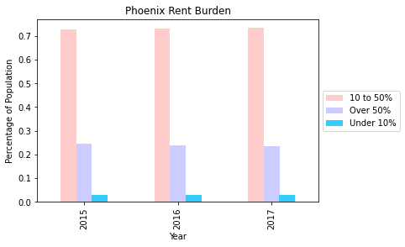
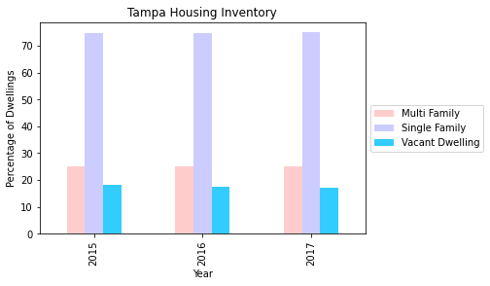
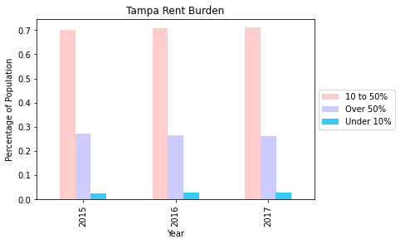
Ways Tampa and Phoenix Are The Same

Slide 8


Data Workflow
Training
data
Data cleaning
Clean
training data
Build
model
Drop rows or columns
Feature
engineering
Raw data
Check missing values
Replace missing values
Clean
test
data
Test
data
model
Predictions

Slide 9
Feature Engineering
Grouping example:
Group features
Remove redundant features
Ages under 20
Ages 20-60
Ages over 60
Female under 18
Females 19-60
Females over 60
Transform features
Male under 18
Males 19-60
Males over 60
Add new features
From ~240 features in the ACS to 59 to use in our models
Notes:
For feature engineering, our goal was to take the features we gathered from the ACS data and grouped several of them together. One of them is shown in the slide. The feature (female under 18) variable captures information of several individual features such as females under 5, females 5-9 and others. These were then grouped further into an age feature. Akin to this grouping, we also grouped several other features such as rent burden, commute types (public or private), income brackets and size of dwellings etc. We also removed redundant features such as additional geoid which was a blank field and married households, whose information was already captured by family households. Furthermore, we also added additional features such as the water to land ratio in each zipcode of the two cities. This analysis leads us from over 240 features to just 59 of the most relevant features for development of our models.

Slide 10
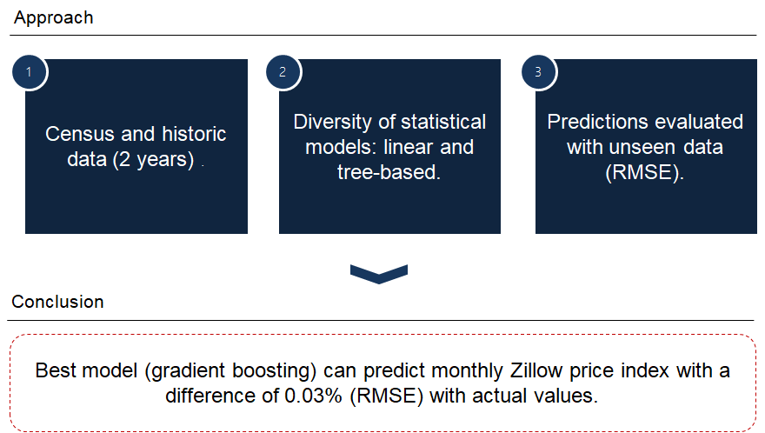
Jumpstart

Slide 11
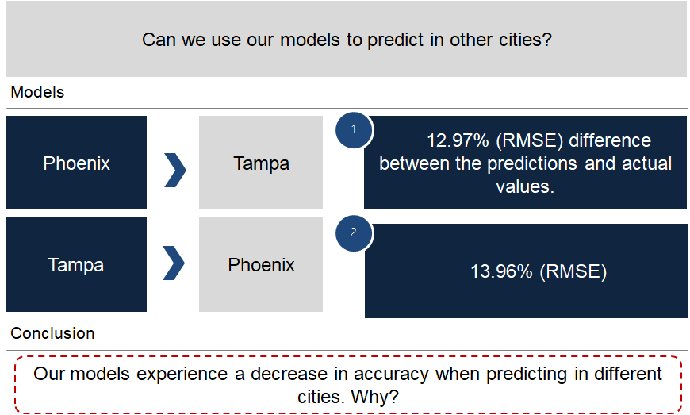
Predicting in Different Cities

Slide 12
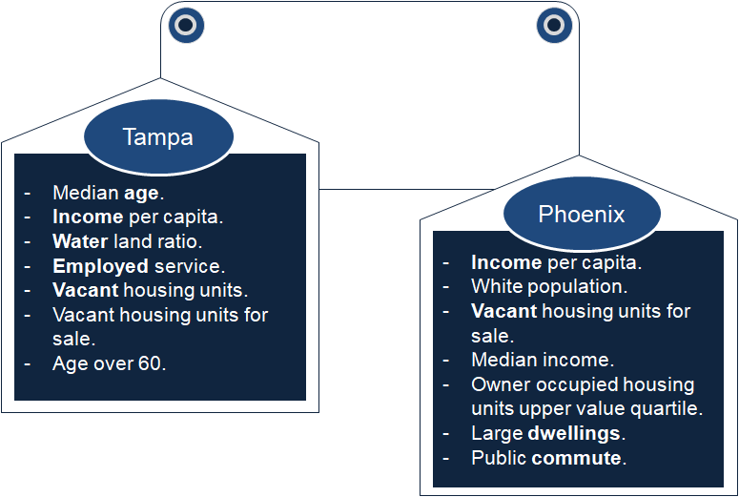
Feature Importance

Slide 13
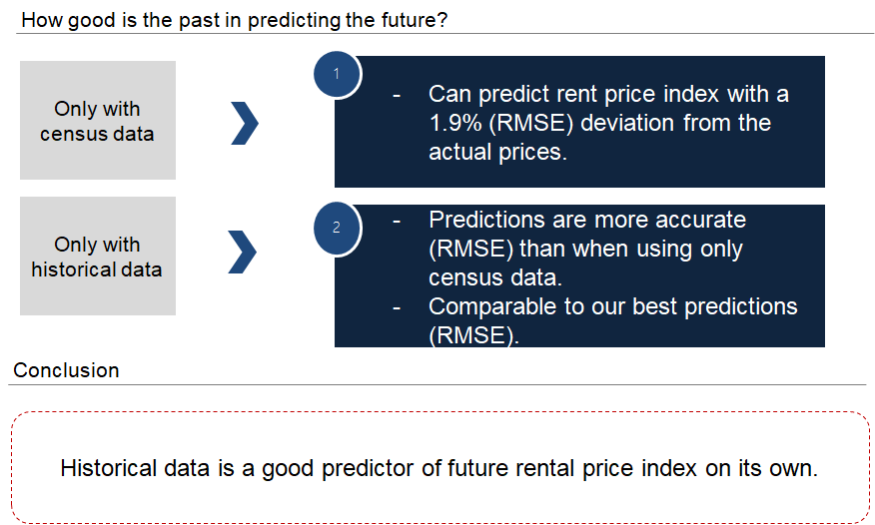
Historical Data for Statistical Modelling

Slide 14
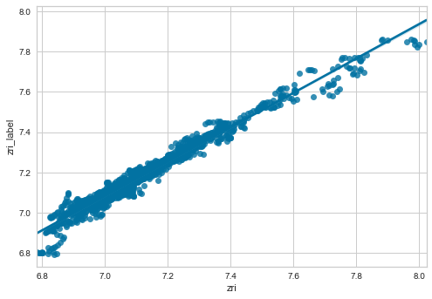
Variations from the Historical Data
 | Variance in rental values explained
 | Phoenix | Tampa
Historical values (linear regression) | 94% | 92%
Residuals (tree-based model using ACS features) | 57% | 64%
Future ZRI
Past ZRI

Slide 15
Feature Importance

Slide 16
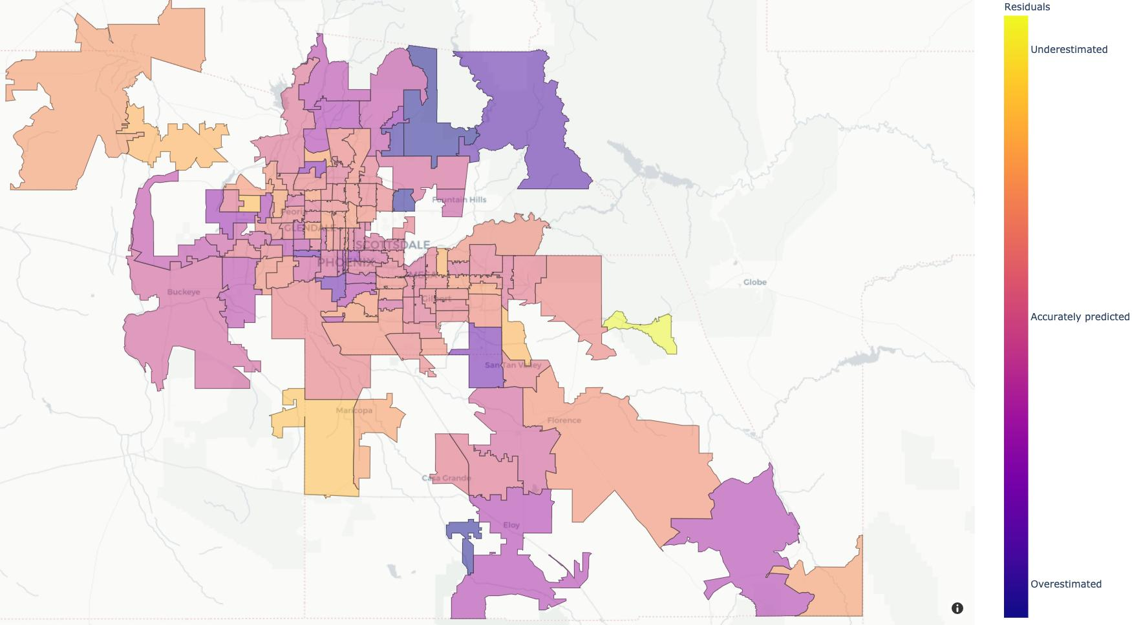
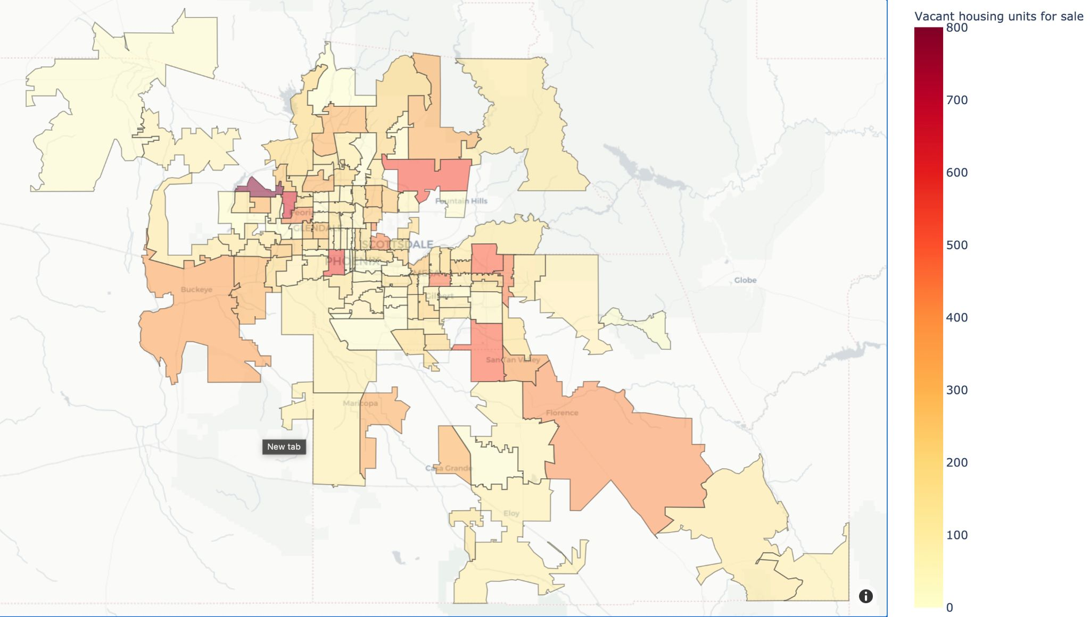
Phoenix
Residuals
Income per capita
Underpredicted
70 K
Accurately
predicted
50 K
30 K
Overpredicted
Vacant housing units for sale
700
Highlights Zip Codes with potential for investment in rental properties
Shows in which Zip Codes the historical model is optimistic. Word of caution- extended vacancy durations!
400
100

Slide 17
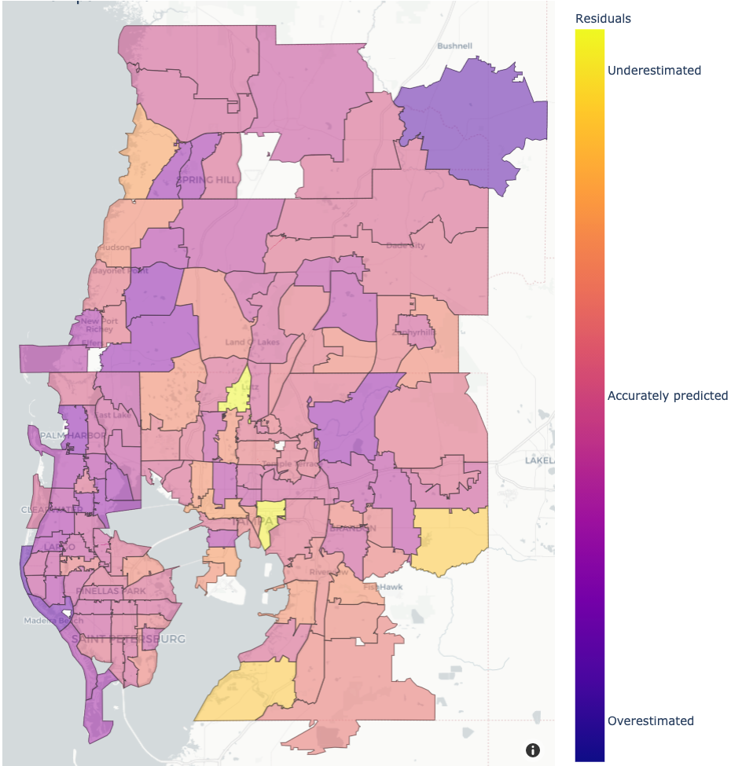
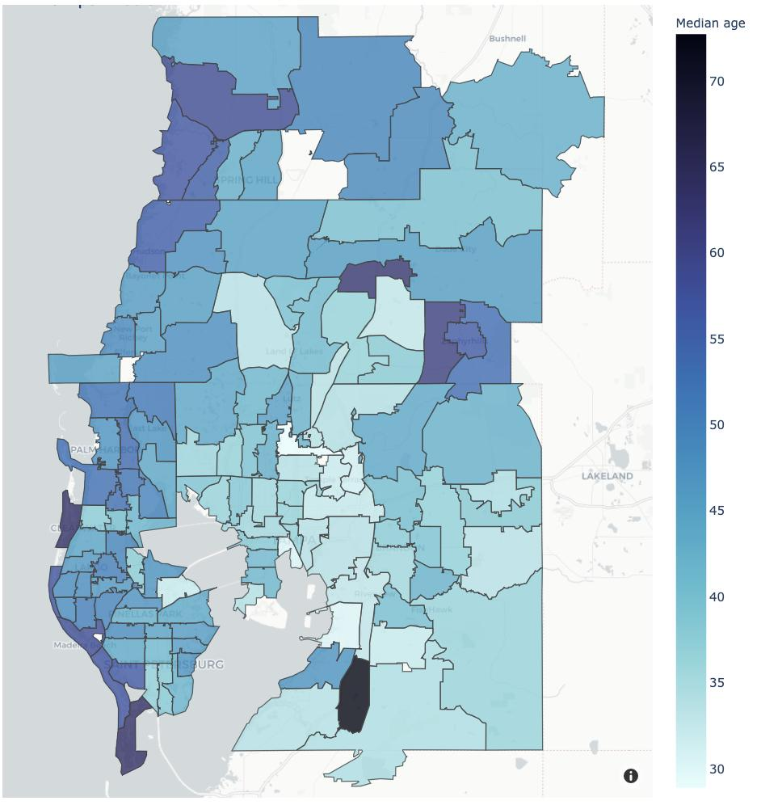
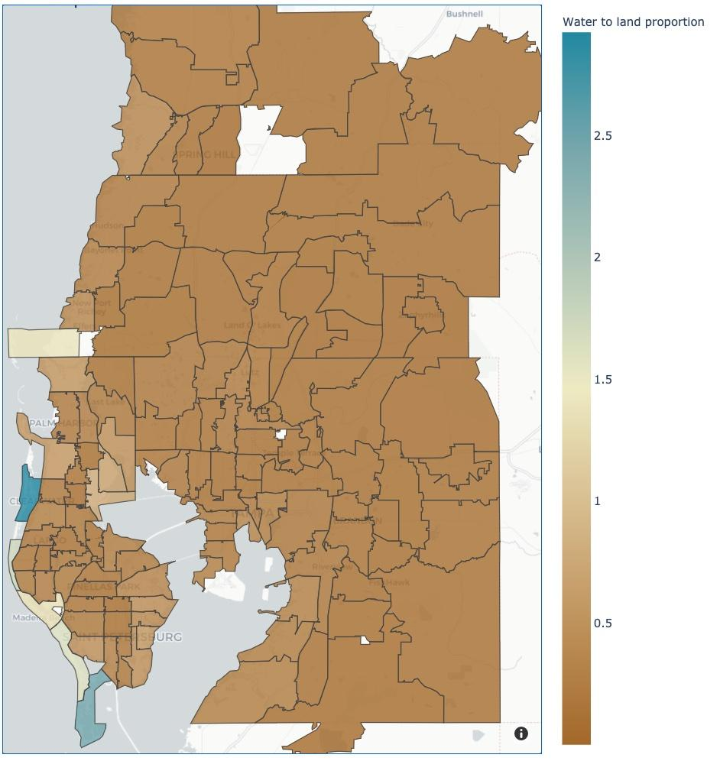
Tampa
Residuals
Age
Income per capita
Water/Land
Underpredicted
70
70 K
2.5
Accurately
predicted
50 K
50
1.5
30 K
0.5
Overpredicted
30
Highlights Zip Codes with potential for investment in rental properties
Shows in which Zip Codes the historical model is optimistic. Word of caution extended vacancy durations!
Demonstrates innate weakness of the ZRI on accurately describing certain sectors

Slide 18
Future Work
Exploring other cities
Incorporating other data sources to improve our predictions
Perform a residual analysis on the ZORI data to find new insights
Creating an interactive app to explore rental index data insights
Study some features more deeply
Attempt time series analysis
Investigate factors that affect seasonality of rental index
Explore how our models could change to accommodate the impact of COVID19

Slide 19
Acknowledgements
NYC Data Science Academy
Luke Lin (mentor)
Thomas Laetsch
Eugenia Dickinson
7 Park
Eugene Wu
Kyle Weber
Questions?

